Slide 1
The Circuit
By Harrison Lessner, Dhruv Rana, Xavier Warner, and Damon Wich

Slide 2
Website Purpose
Team Members: Leader - Xavier Warner, Co-Leader - Dhruv Rana, Harrison Lessner, Damon Wich
The purpose of this website is to make a website that allows users to buy and sell their owned PC Parts. This is similar to the Facebook marketplace but instead of selling and buying anything there, we are only selling and buying computer parts.
The motivation behind this website is that computer parts have skyrocketed in price over the years due to scalpers or just unfair prices from high-up companies. So team Circuit has decided to make an online e-store specifically tuned to computer parts so customers can shop online.
Our website is an e-store to allow customers to do online shopping. Although this e-store is specifically tailored to selling and buying computer parts. High-up companies do not sell these computer parts, but instead, they are sold by users themselves.

Slide 3
Technologies Used
To create our website we used
Html
PHP
CSS
JavaScript
MySql Database.

Slide 4
Website Architecture ~ 1
Each page is linked to one another through the navbars that is present in all major pages.

Slide 5
Website Architecture ~ 2
File Name | Function/Purpose | Related Page(s)/Components
index.php | This page allows the user to login to our website with a username and password, giving them access to our website. | This page is related to the createaccount.php page as it is linked to it, and the user needs a account to login. This page is also related to home.php, and admin_home since when the user logs in they will be directed to the home.php or if they are an admin, to admin_home.php.
signout.php | This page is for signing out the user when the signout button is pressed. | This page is related to home.php, cart.php, profile.php, addproducts.php, checkout.php, thankyou.php, navbar.php., admin_navbar.php, checkout_cart_clear_navbar.php, admin_home.php, and delete_users.php.
addproducts.php | The page is a form where the user can add an item to the website’s database. The user will input information such as an item image, name, description, features, and price. Submitting the form will add the item to the home page. | This page is related to the home.php and admin_home.php so that the items can be shown on the homepage. It is also related to profile.php, as the item added by the user will be seen in their profile.

Slide 6
Website Architecture ~ 3
File Name | Function/Purpose | Related Page(s)/Components
profilepage.php | This page allows the user to see their username, userID, and other details. Also, this page allows the user to see the items that they have put up on the website. | This page is related to index.php to select the profile option from the navigation bar.
cart.php | This page shows the user which items they want to buy allowing them to remove items if necessary and also check out items as well. | This page is related to checkout.php so that once the user has added items to the cart, they can proceed to buy the items by entering their payment details. add_to_cart.php connects a button in home.php that adds the product to the cart. remove_from_cart.php connects a button that removes a item from cart. update_cart_quantity.php updates the quantity of a product in cart. clear_cart.php connects a button in the cart that clears the cart. process_totalcost.php, which calculates the total in the cart and connects it to the thankyou.php.

Slide 7
Website Architecture ~ 4
File Name | Function/Purpose | Related Page(s)/Components
Add_to_cart.php Remove_from_cart.php Update_cart_quantity.php Clear_cart.php process_totalcost.php | Add a item to cart Remove a item from cart Update item quantity in the cart Remove all items in the cart Calculate the total cost of cart for thankyou.php | All these pages are related to the cart.php, checkout.php and thankyou.php.

Slide 8
Website Architecture ~ 5
File Name | Function/Purpose | Related Page(s)/Components
checkout.php | This is where the user inputs their payment and credit card information, and then by clicking check out, they purchase the items in their cart. | This page is related to thankyou.php after filling out all required information, it is also related to cart.php so it displays the accurate totals of items and the final cost.
thankyou.php | This page thanks the user for the purchase, shows the purchased items, and displays their payment details. | This is related to the checkout.php page as it requires the data from the checkout.php page to work properly, and display the payment details. process_totalcost.php, which calculates the total in the cart and connects it to the thankyou.php to display the total cost. It is also connected to cart.php which retrieves the cart items purchased.
editproducts.php | This page allows the user to edit the product details for the products they have added to the website. | This page is related to the profile.php page as the user must navigate to this page to edit products. This page is also related to the addproducts.php as only the products added by the user can be edited.

Slide 9
Website Architecture ~ 6
File Name | Function/Purpose | Related Page(s)/Components
home.php | This is the main hub for the website with a search function and an item function. Search Function: This function allows the user to search for specific items on the homepage that match the words that they inputted. For example, if the user inputs “ball” then only related items to the word ball will show up Item function: This function shows all the items to the users, and the ability to add the products to the cart. | This page relates to most other pages as it is the directory for every page.

Slide 10
Website Architecture ~ 7
File Name | Function/Purpose | Related Page(s)/Components
createaccount.php | This page allows new users to sign up to our website so that they can access our website. This requires you to input: username, email, and password | The createaccount.php page is related to the index.php as after you create an account it goes to the login page.
admin_home.php | This is the main hub for the website for the admin with a search function and an item function. Search Function: This function allows the user to search for specific items on the homepage that match the words that they inputted. For example, if the user inputs “ball” then only related items to the word ball will show up Item function: This function shows all items to the admin, and allows the user to delete products from the database. | This page is related to index.php as the user must log in as an admin to access admin privileges. This page is also related to delete_item.php since the admin can delete products from the admin home page through a delete button.

Slide 11
Website Architecture ~ 8
File Name | Function/Purpose | Related Page(s)/Components
delete_item.php | This page allows the admin user to delete items on the website. | This page is related to admin_home.php as the user must have admin privileges to delete items.
delete_users.php | This page allows the admin user to remove and ban users from the website. | This page is related admin_home.php as the user must have admin privileges to access this page from the navbar.
database.php | This is the database connection file using PDO. | This is connected to all the files for the website.

Slide 12
Website Architecture ~ 9
File Name | Function/Purpose | Related Page(s)/Components
navbar.php | This page is related to the navbar feature of the website. | This page is related to home.php, cart.php, profile.php, addproducts.php, checkout.php, and signout.php
admin_navbar.php | This page is related to the navbar feature of the website for the admin user. | This page is related admin_home.php, and delete_users.php, and signout.php
checkout_cart_clear_navbar.php | This page is related to the navbar feature for thankyou.php to clear the cart after the user has made a purchase. Navigating to any page from the thankyou.php page through the navbar will clear the cart. | This page is related to home.php, cart.php, profile.php, addproducts.php, checkout.php, thankyou.php and signout.php.

Slide 13
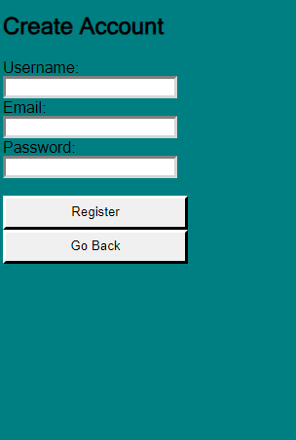
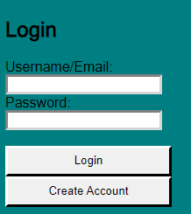
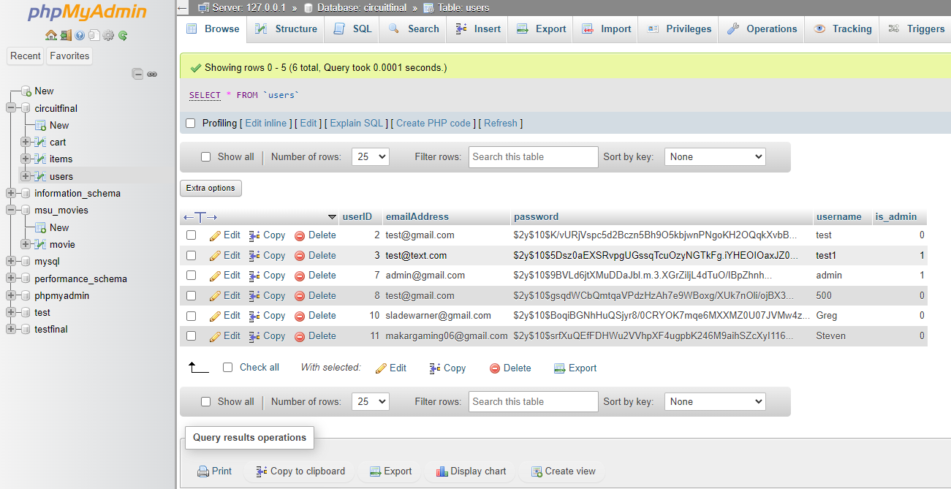
Website Features ~ 1
The first feature we implemented was a working login page and create account page. This updates directly to our database and also associates the user with a unique user ID.

Slide 14
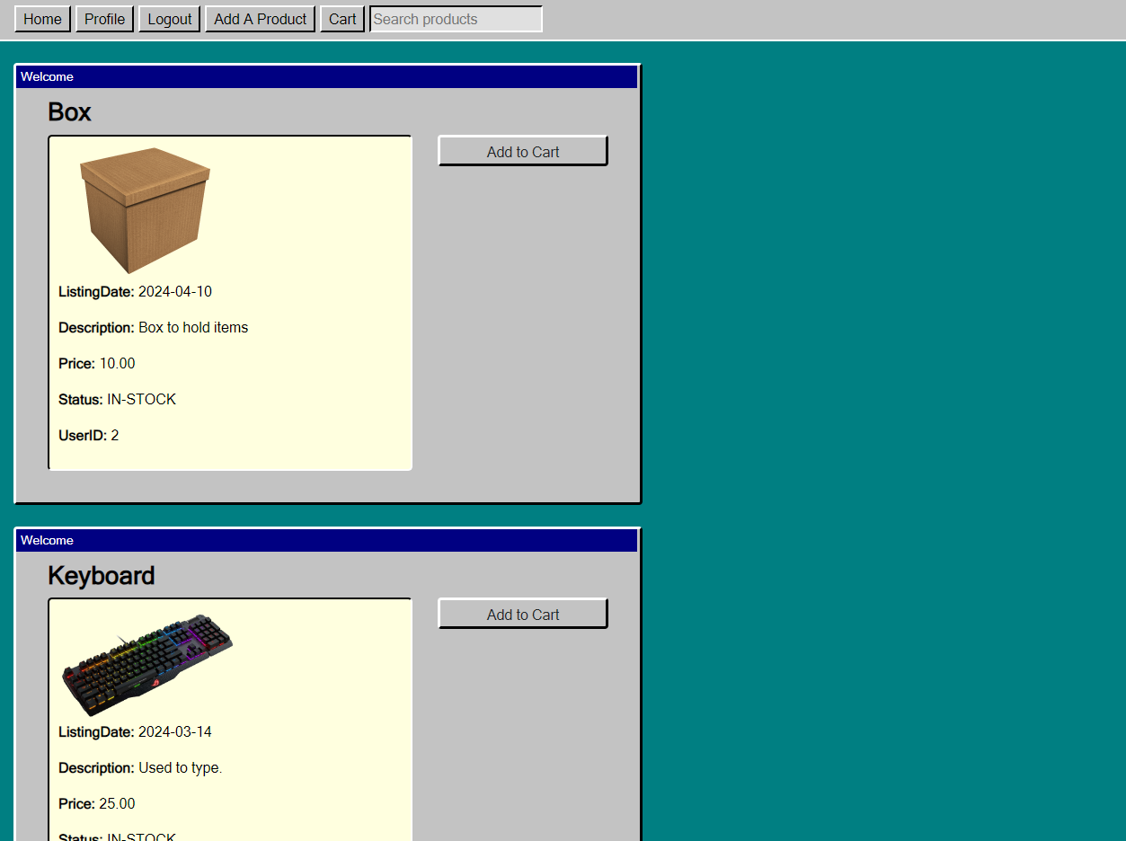
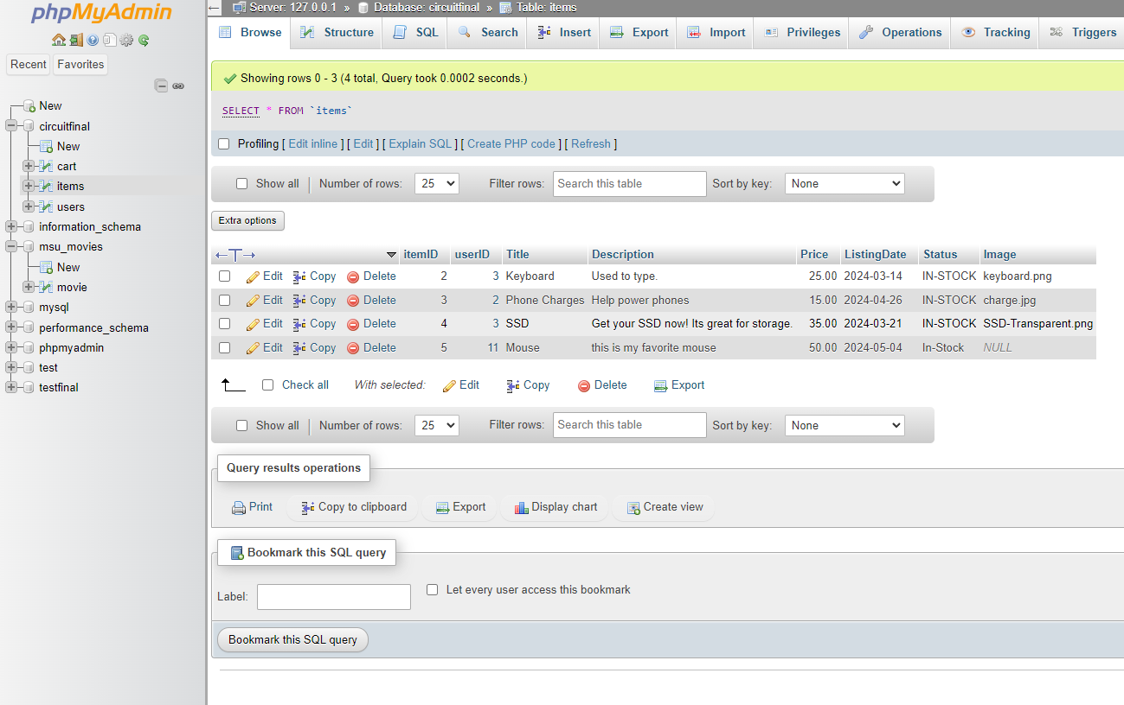
Website Features ~ 2
Our homepage shows the items added by other users available for purchase, this is updated live by our items database.

Slide 15
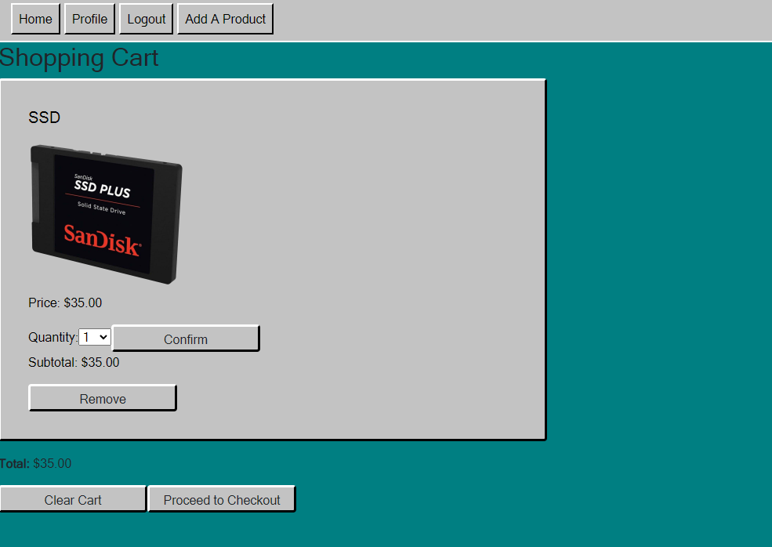
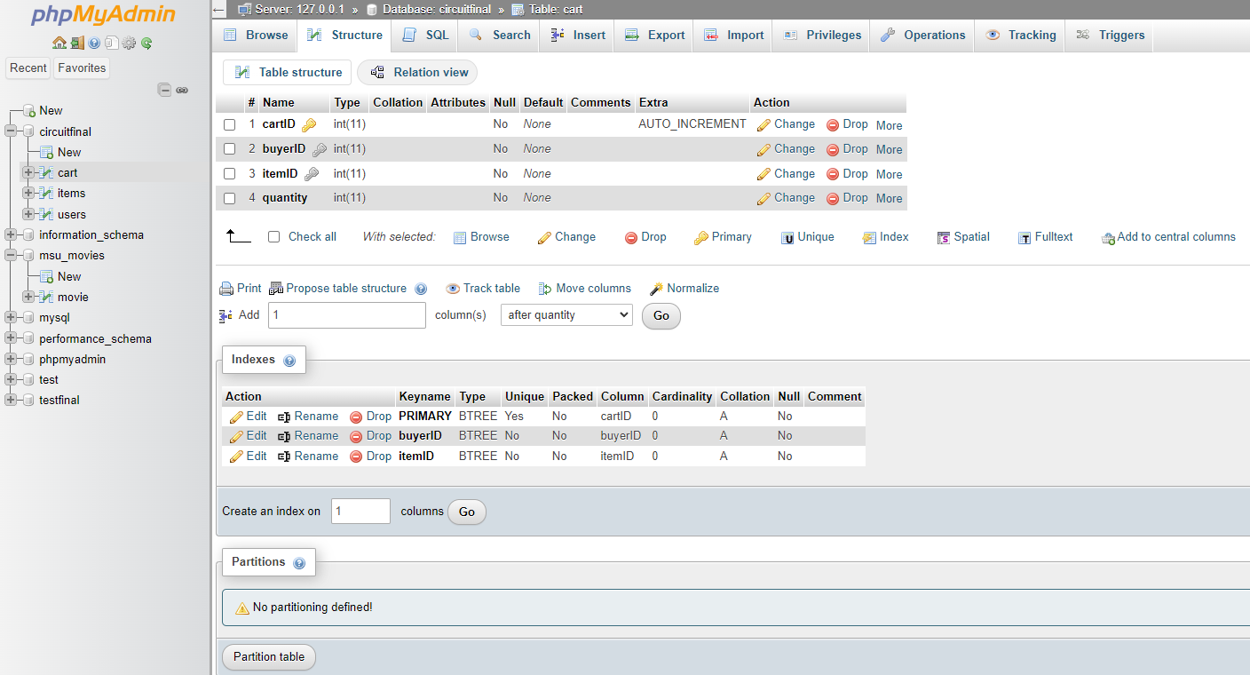
Website Features ~ 3
Our cart page directly interacts with our homepage to take items and associate them with your user ID to show what is in your cart. This also updates the cart database and connects to the checkout screen following. You can also change the quantity of the selected item, as well as remove the items in your cart.

Slide 16
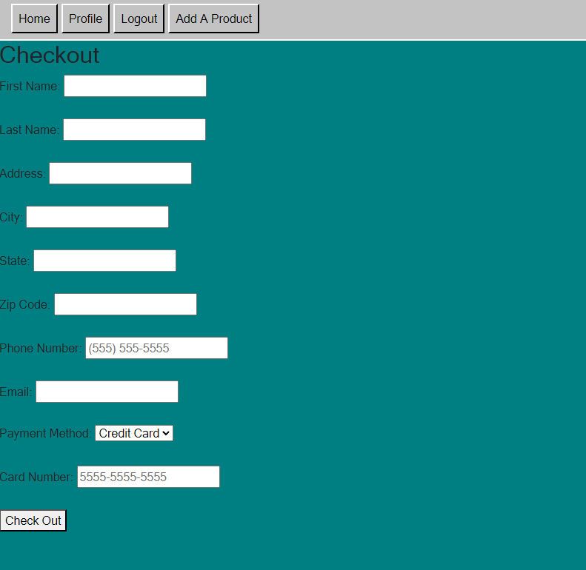
Website Features ~ 4
The checkout page connects directly to the cart page prior and asks you to enter the required fields before showing you the confirmation page.

Slide 17
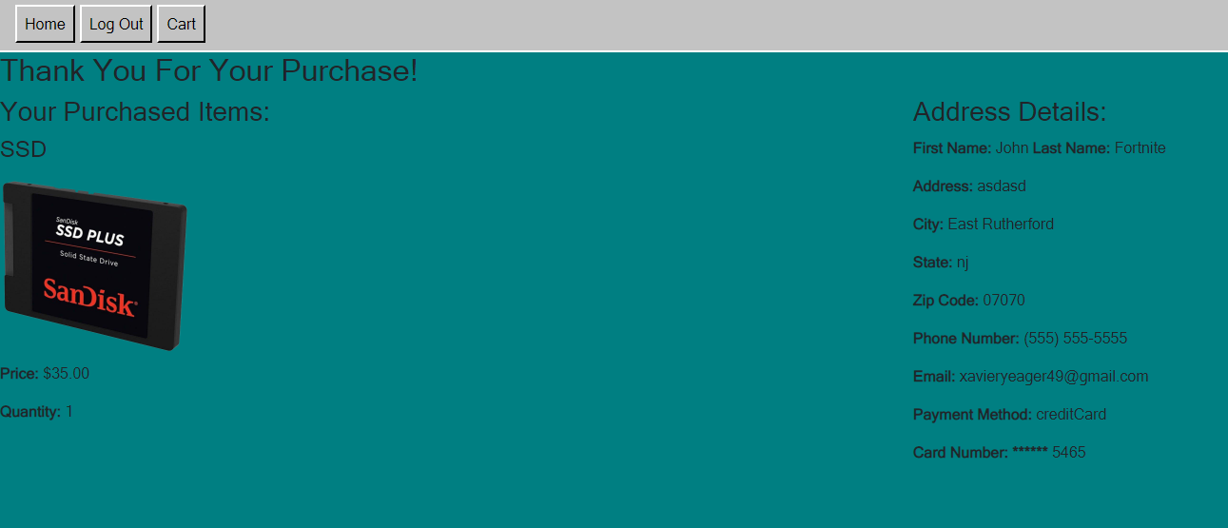
Website Features ~ 5
The confirmation page just displays the information given on the checkout page to let the user know their order has been processed.

Slide 18
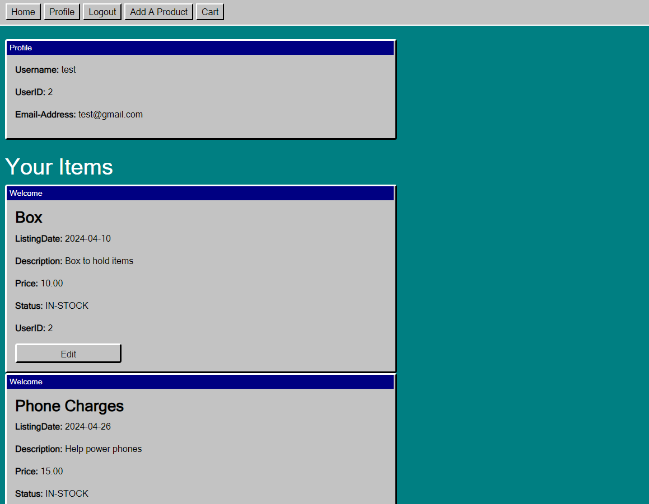
Website Features - 6
The profile page displays your account information as well as whatever items you have added to the marketplace on the home page. This also gives you the option to edit your items that your selling.

Slide 19
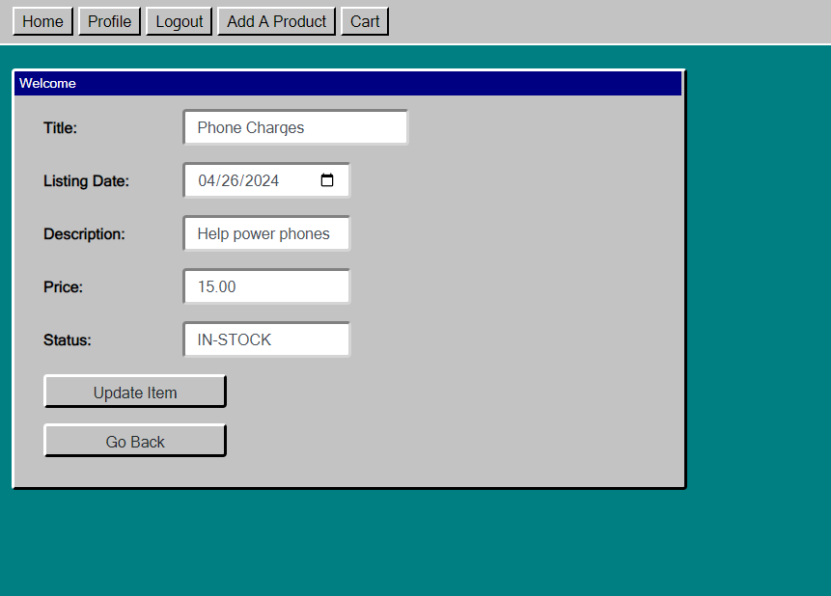
Website Features - 7
This forum is related to the profile page. Its related by when a user clicks on the edit button to update a product of their own. When a user clicks on the edit button they are shown a forum from where they can edit there existing item.

Slide 20
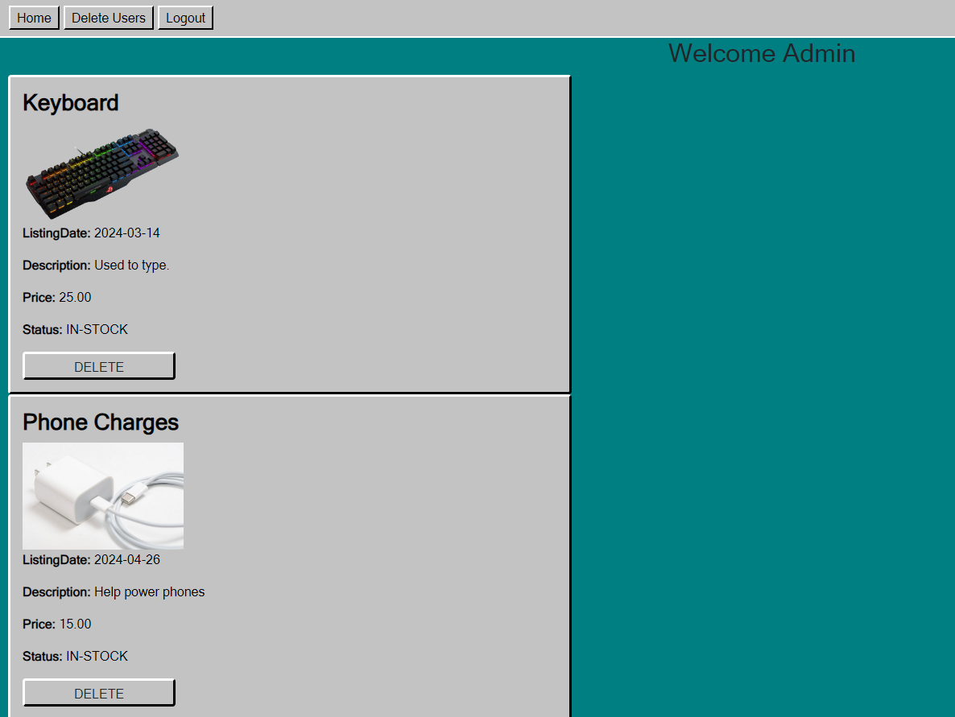
Website Features - 8
This is the admin page when an admin logs into their account this is the first thing they will see. What will be shown is a list of items from the database that they can delete and links uptop that go to the admin home page, delete users page, and log out button.

Slide 21

Website Features - 9
After the admin has clicked the delete users button on the admin page. The admin will be transferred to the delete users page. Where they can delete users(including other admins) from our database but not themselves as you can see that the delete button is not shown for that specific admin account

Slide 22
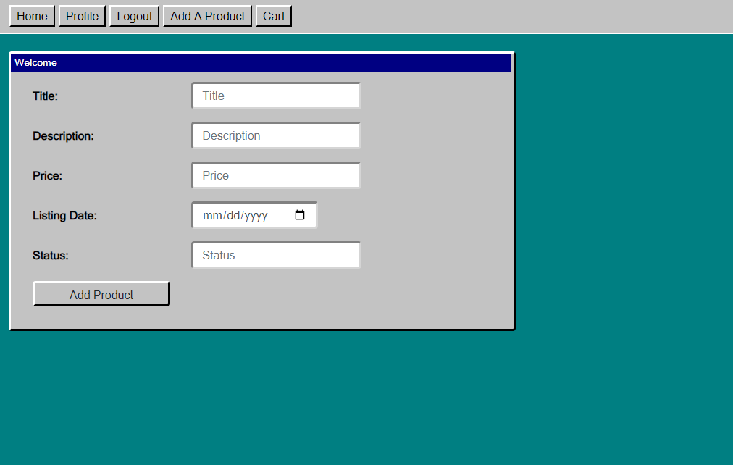
Website Features - 10
The add products page allows our users to add products to the marketplace for other users to add to their cart and purchase. It also lets you choose the listing date as well as the status of your listing.

Slide 23
Features Not Implemented / Future improvements
The only feature our group wanted to implement and were unable to was the ability for users to upload images for the products they post.
If given more time, we would like to make the website design and layout more clean and neat. We are happy with the outcome of every other feature we have implemented so far.

